Slide 1


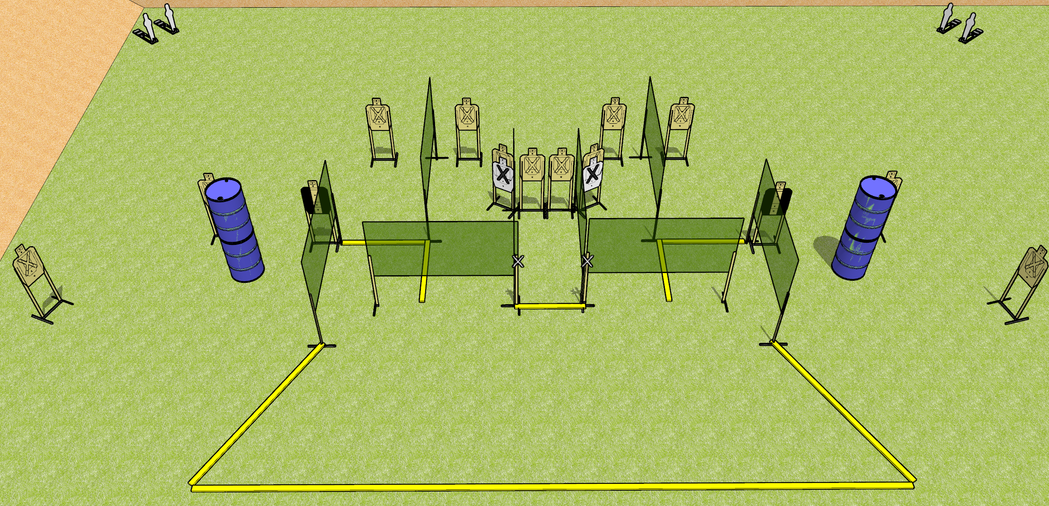
 | Dothan Gun Club – USPSA Match Hosing Course Designer : Drew Coleman
START POSITION : Standing with both hands touching X’s. PCC muzzle touching either mark.
GUN READY CONDITION : Pistol unloaded and holstered. PCC unloaded, shouldered, held with both hands, safety on, muzzle touching either mark. |  | SCORING: Comstock, 32 rounds TARGETS: 14 paper, 4 Steel SCORED HITS: Best 2 on paper, steel until down START-STOP: Audible, last shot RULES:
STAGE PROCEDURE: Engage targets as they become available from within the fault lines.

Slide 2
Hosing
Written Stage Briefing
Hosing is a 32 round, 160 point, Comstock field course. There are fourteen USPSA targets and four mini poppers. The best two hits on paper will score, and steel must fall to score. The start signal is audible.
Handgun start position is standing with both hands touching marks. Handgun is unloaded and holstered.
PCC start position is standing with muzzle touching either mark. Unloaded carbine is held with both hands, shouldered.
On start signal, engage targets as they become available from within the shooting area.

